Slide 1
TraceBook
Design and Implementation of Security-Conscious,
Location-Sharing in a Geosocial Network

Slide 2
TraceBook
Supervisor: Dr. Munmun Bhattacharya
Group No. 16
Anumoy Nandy (002011001121)
Kunal Pramanick (302111001005)
Manas Pratim Biswas (002011001025)

Slide 3
Introduction

Slide 4
Context
Advancements in mobile and internet technology
Increase in internet usage and social media connectivity

Slide 5
Context
Issues with traditional social networks
Allegations of user data capture and sale
Breaches in user location data exposing sensitive information

Slide 6
Project Overview
Development of a Privacy Network for scalable Geosocial Networking
TraceBook : A web application ensuring user privacy in location sharing
Features include user registration, friend management, and precise privacy settings and location sharing

Slide 7
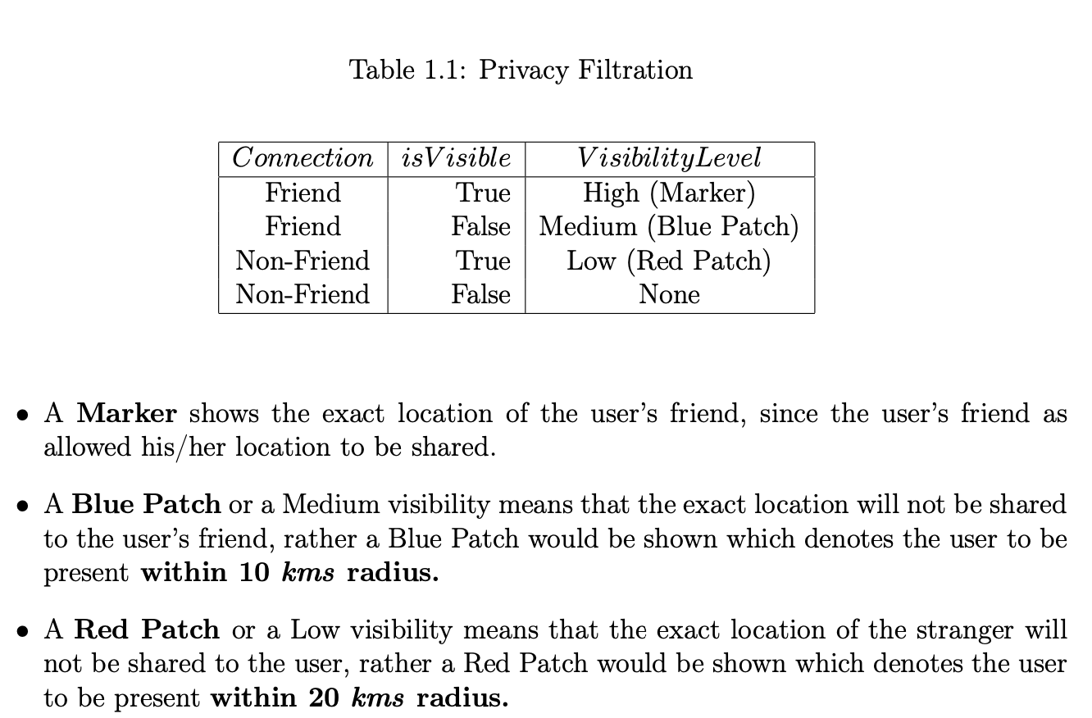

Slide 8
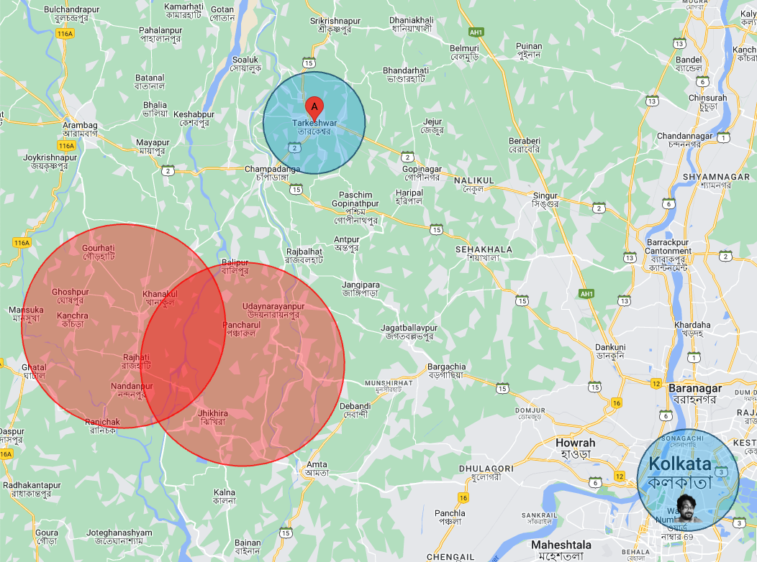

Slide 9
TraceBook Implementation
Database:
1. MongoDB for user authentication and data
2. PostgreSQL with PostGIS for handling user location attributes
Real-time communication:
Use of WebSockets for real-time location broadcasting and multicasting
WebSocket backend server for managing client connections

Slide 10
TraceBook Implementation
Hosting:
1. Frontend is hosted on Vercel
2. Backend is hosted on Render
API Documentation:
Comprehensive Swagger documentation in line with OpenAPI specifications

Slide 11
TraceBook Technologies Used
TypeScript
WebSockets
MongoDB
Express
React
Node
PostgreSQL & PostGIS
Vercel & Render
Git & GitHub

Slide 12
/auth

Slide 13
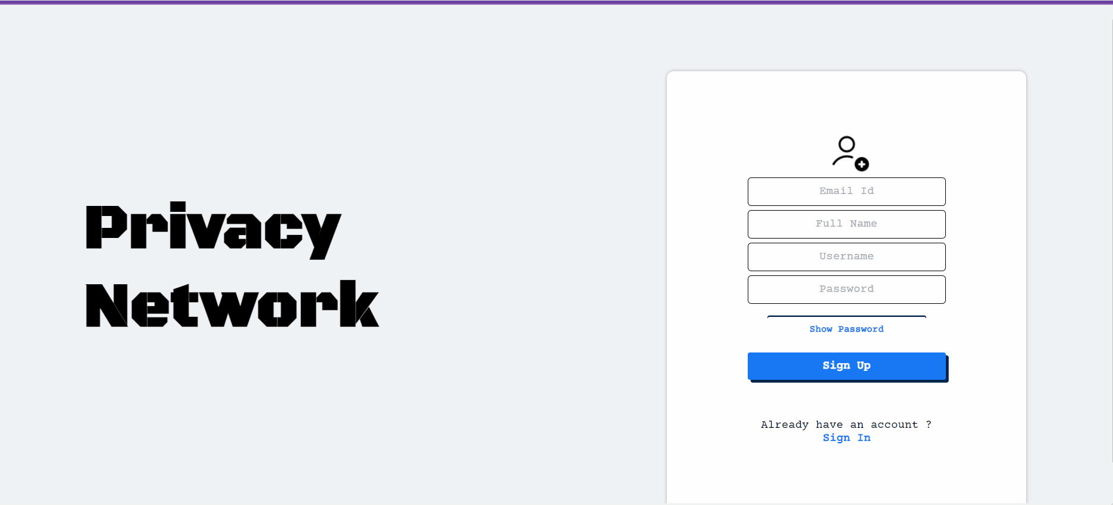

Slide 14
Auth Flow

Slide 15
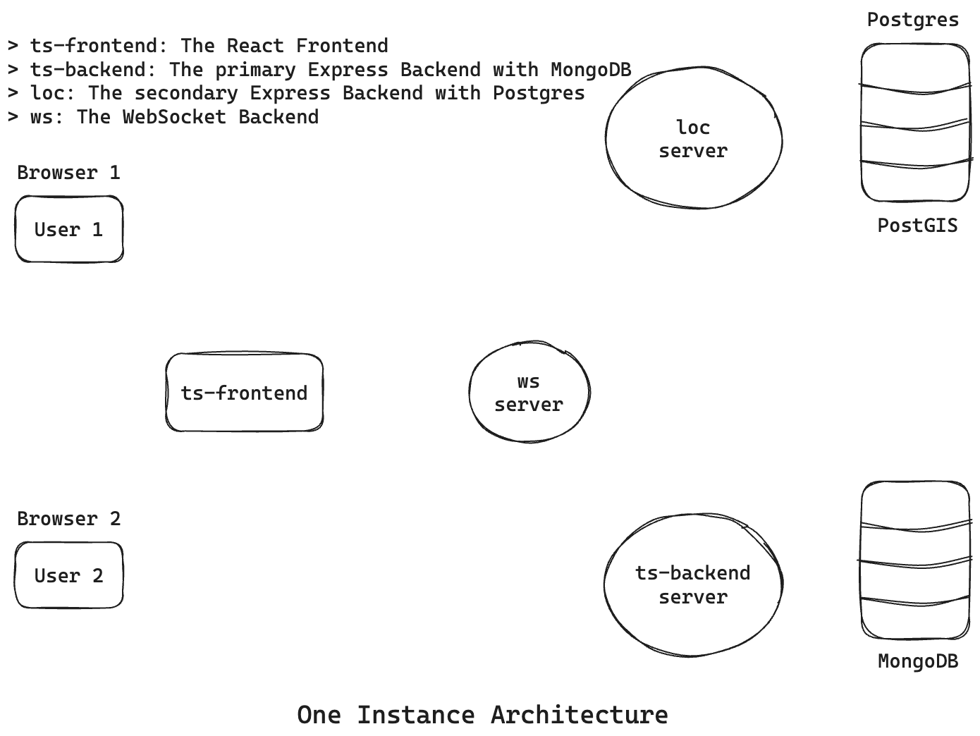

Slide 16
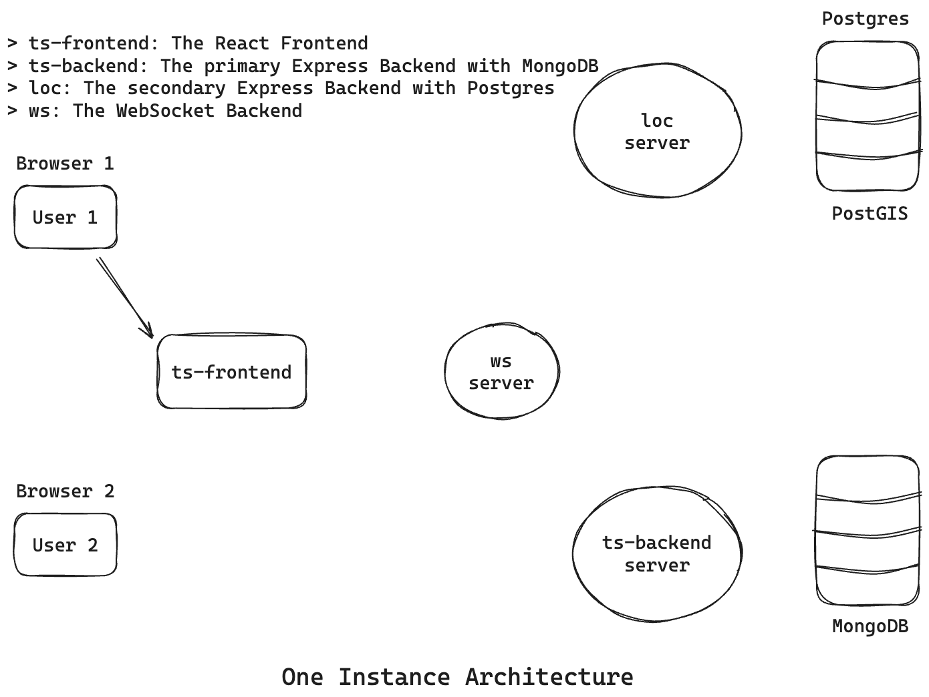

Slide 17
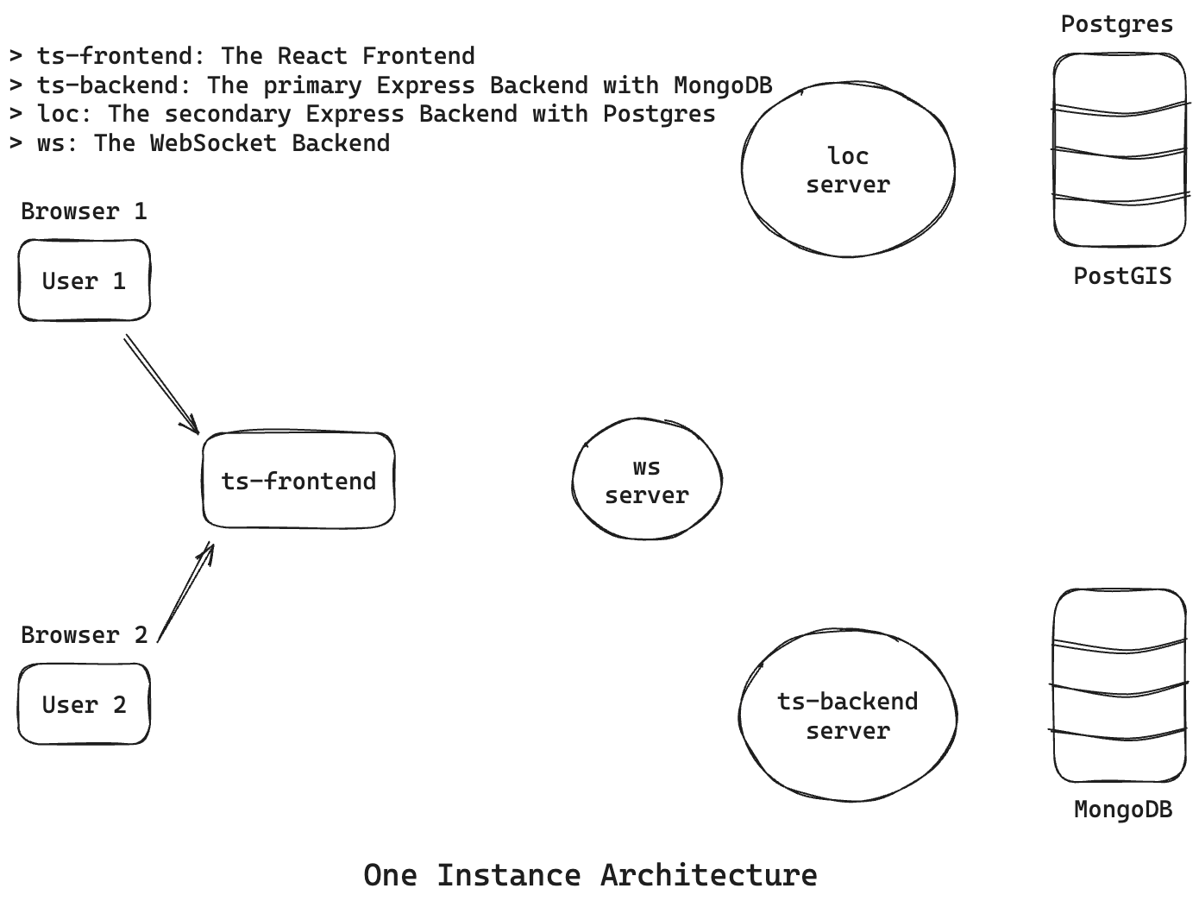

Slide 18
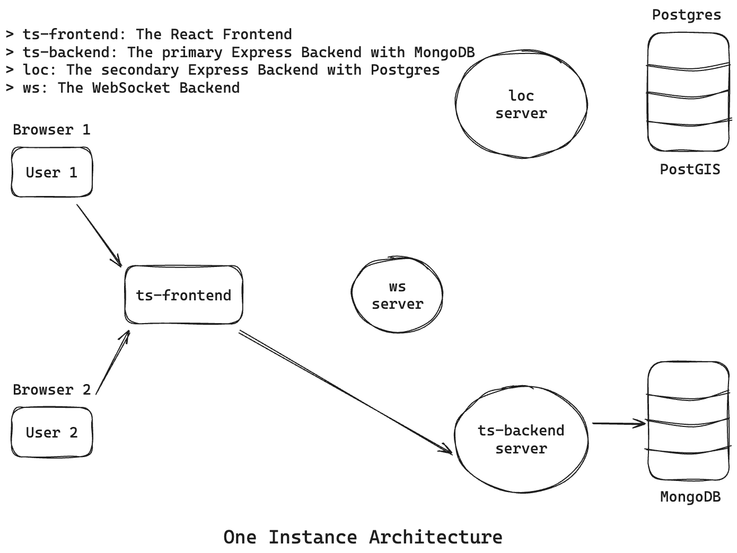

Slide 19
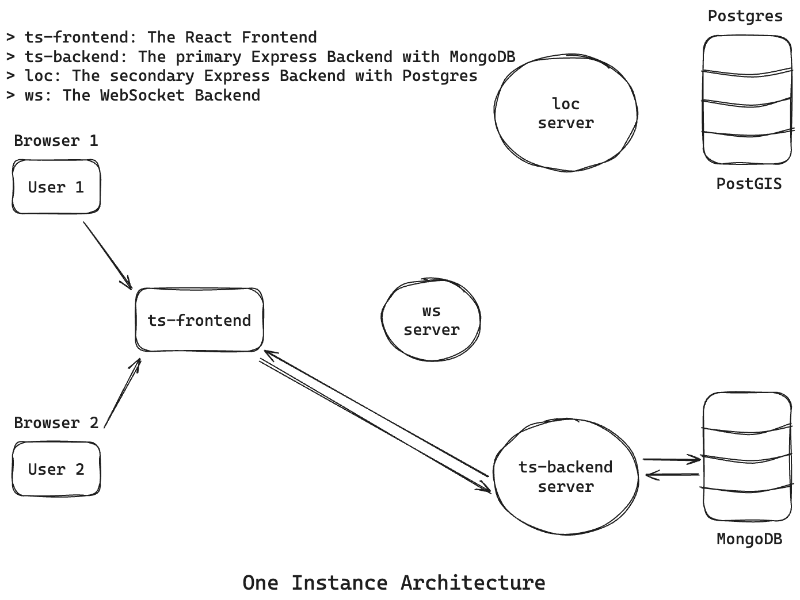

Slide 20
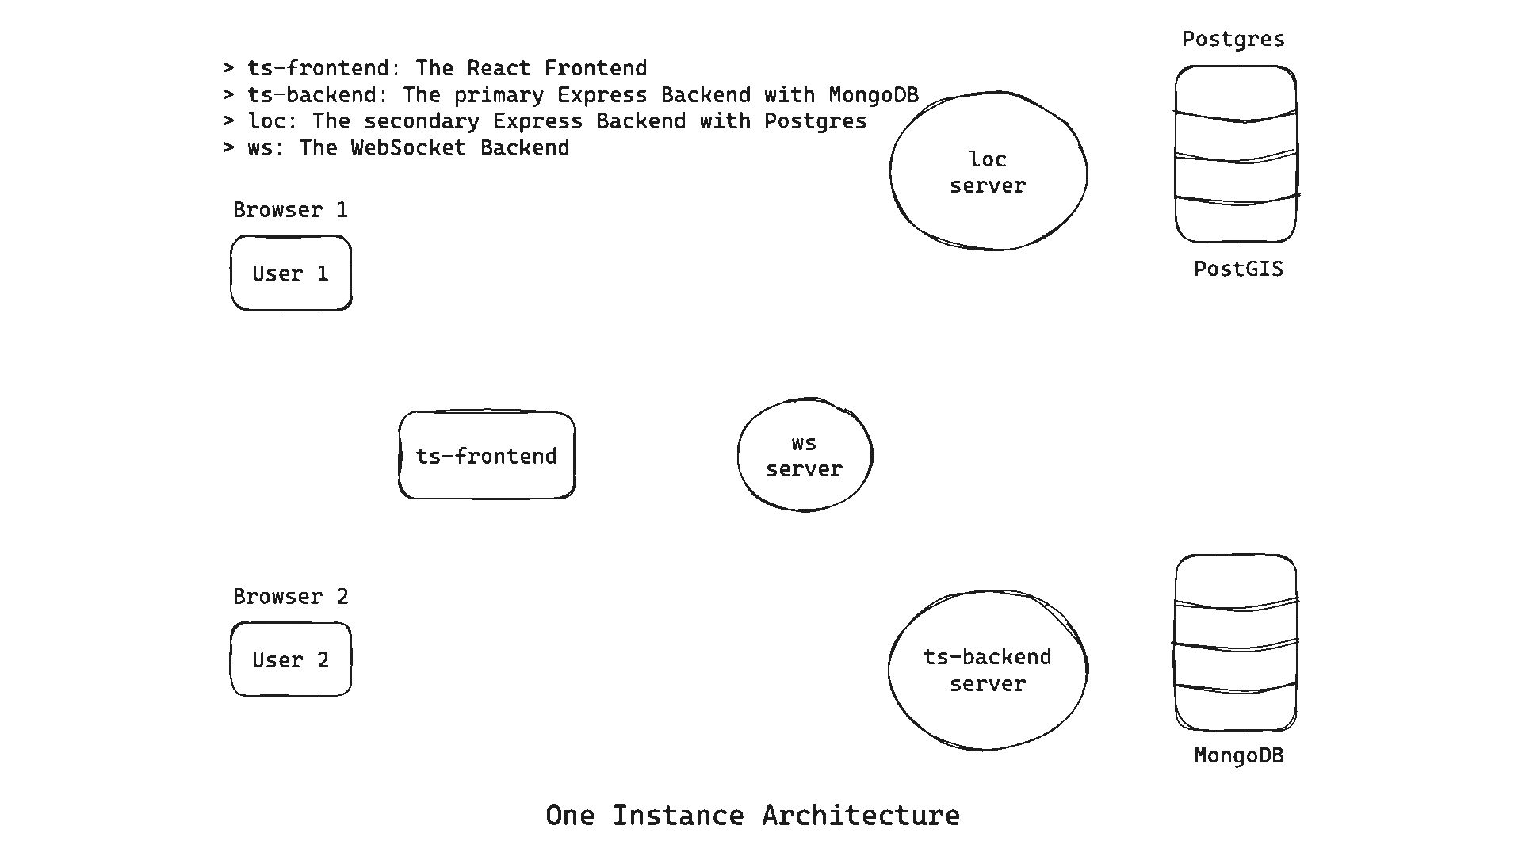

Slide 21
/dashboard

Slide 22
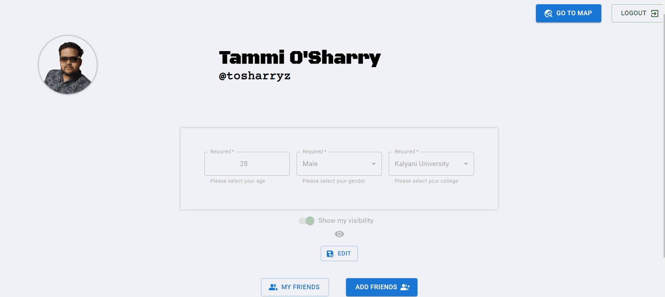

Slide 23
User Details CRUD Flow

Slide 27
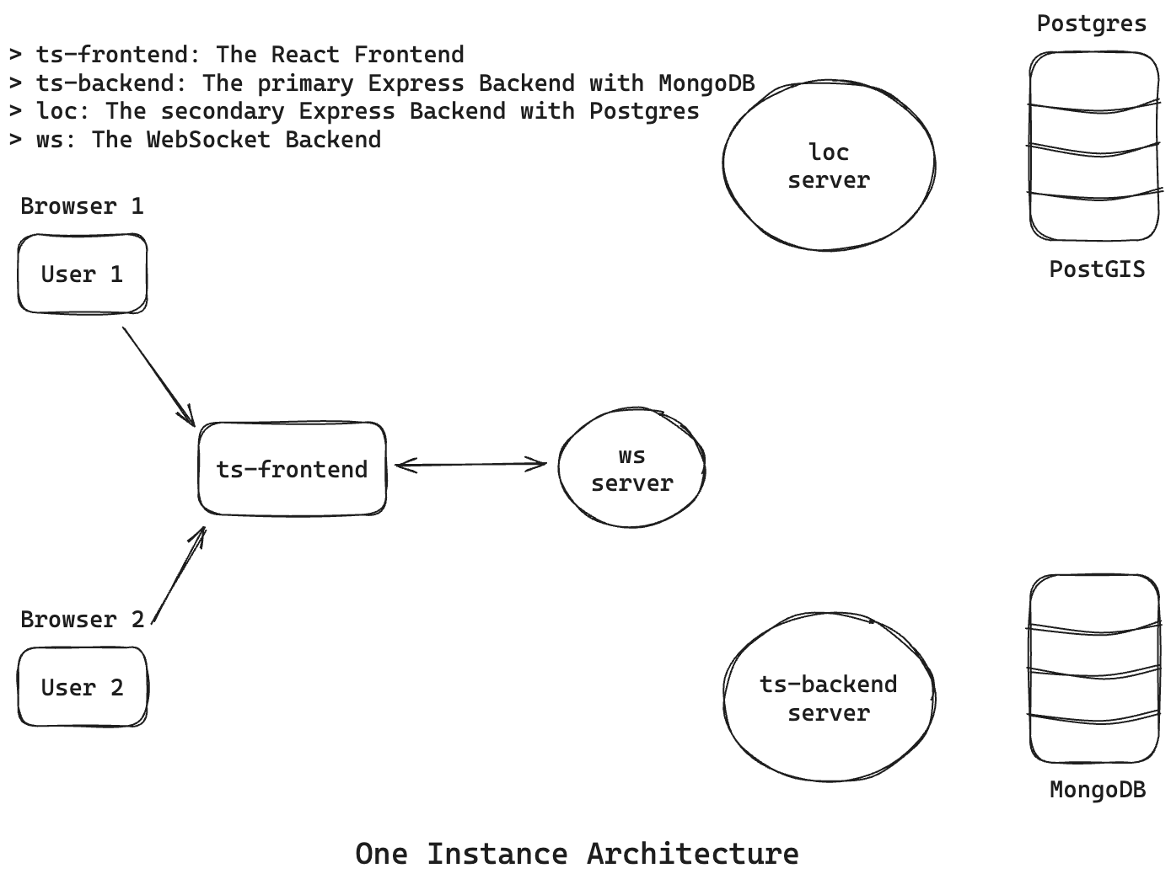

Slide 28
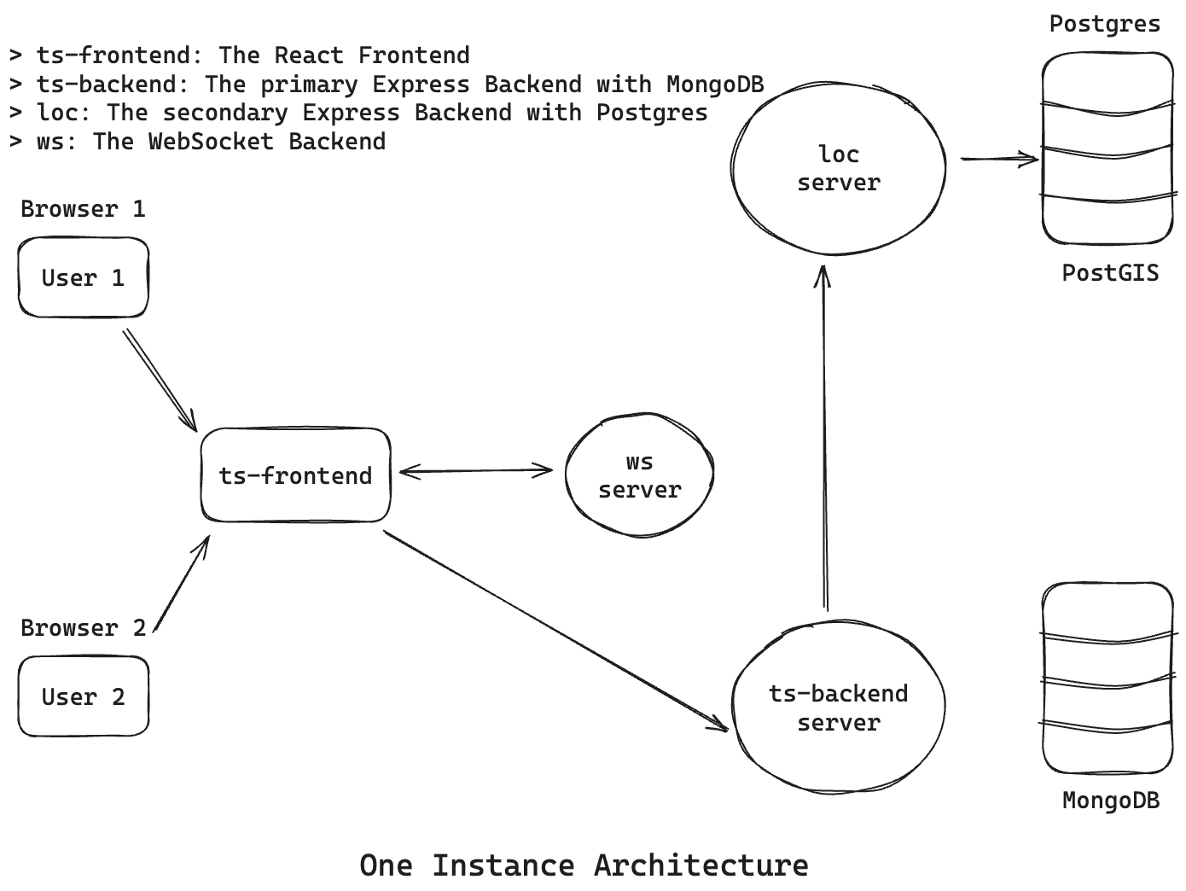

Slide 29
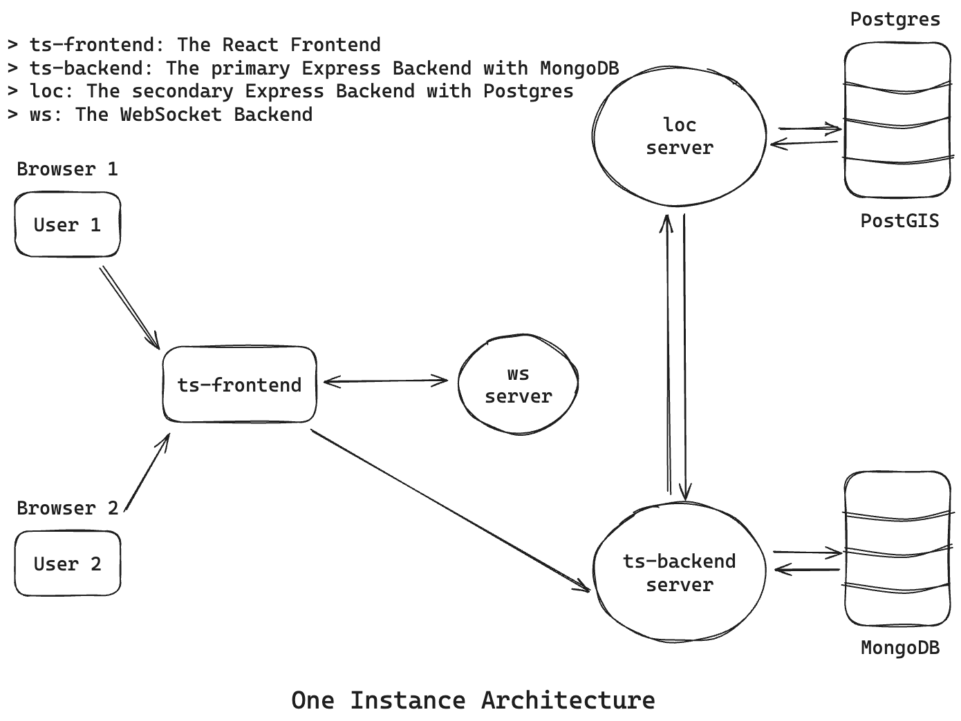

Slide 30
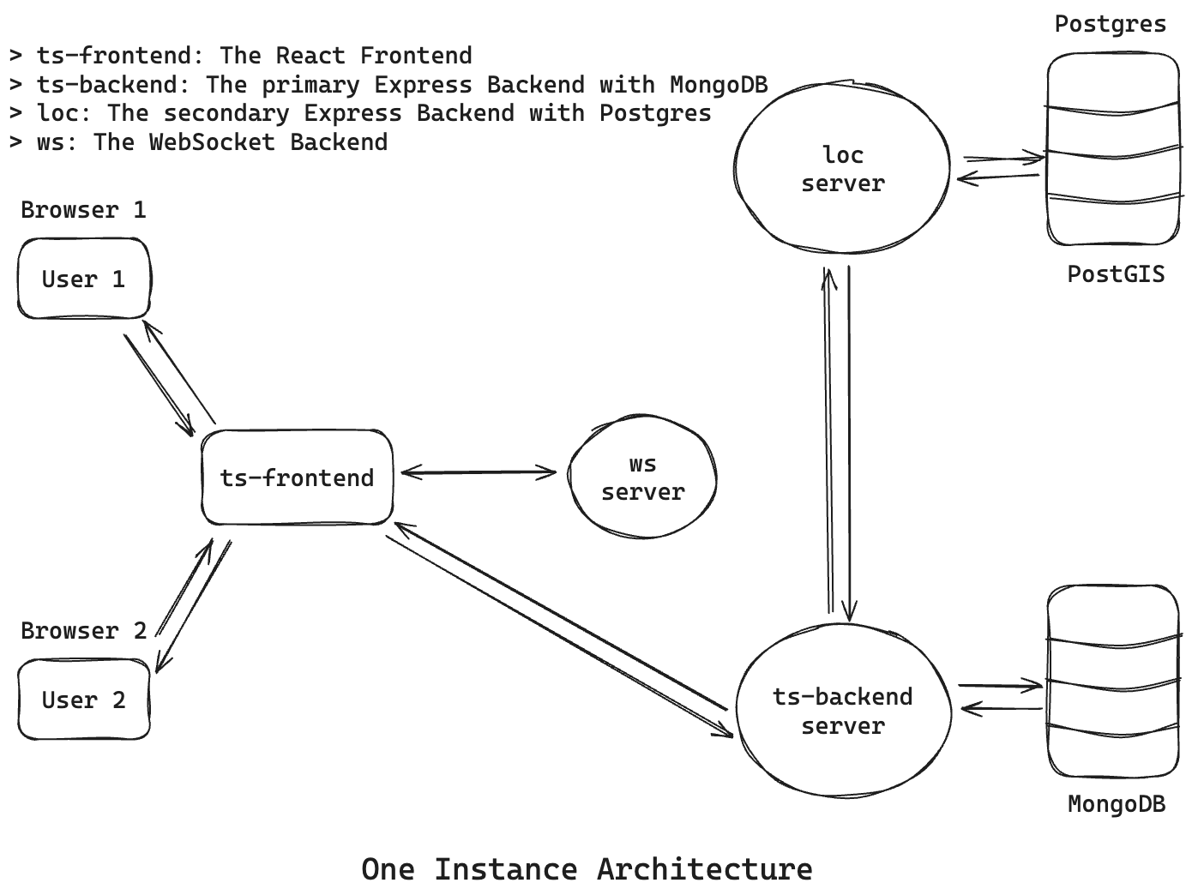

Slide 31
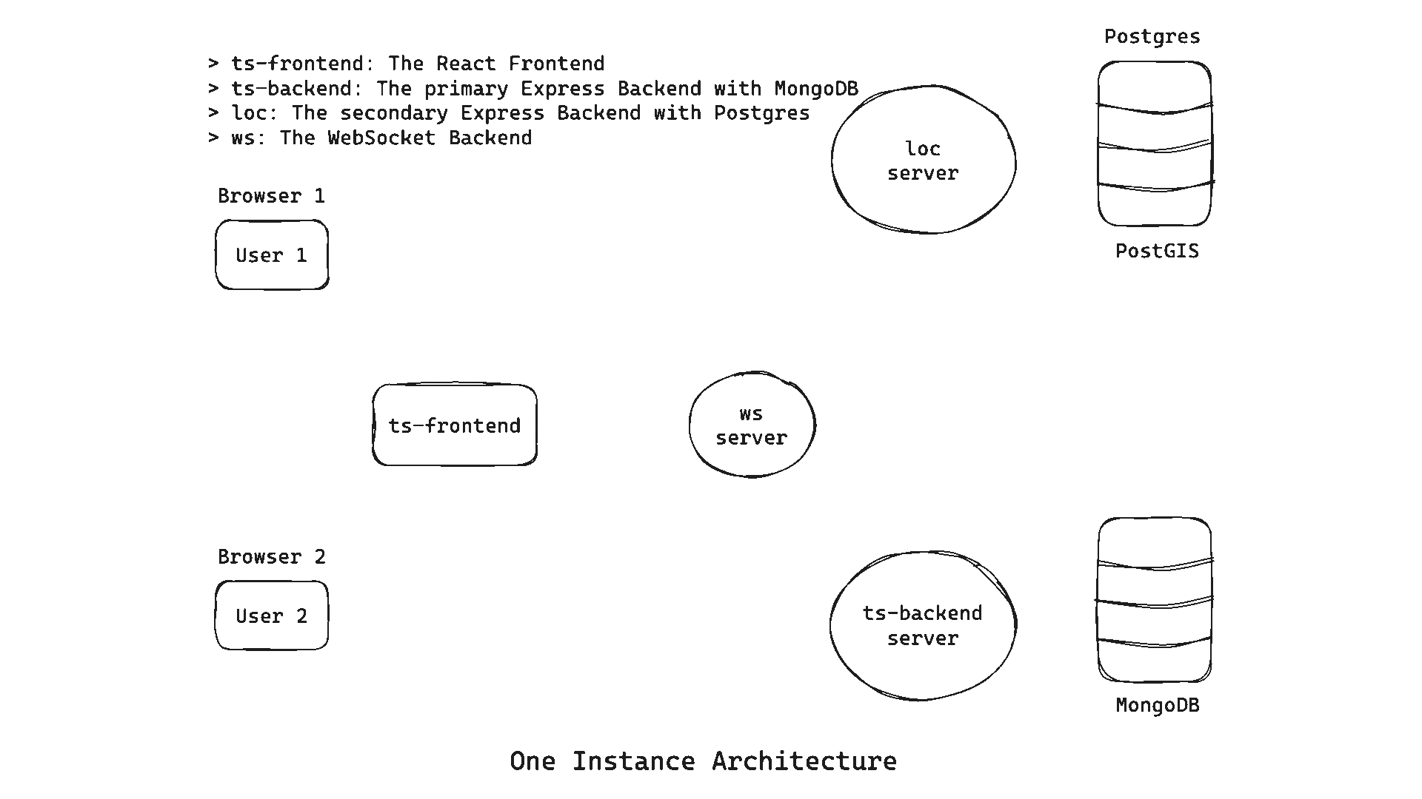

Slide 32
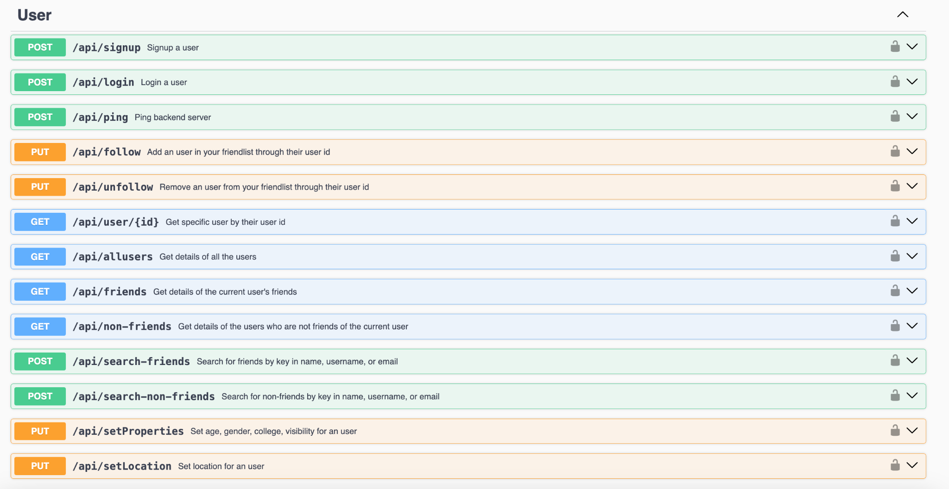

Slide 33
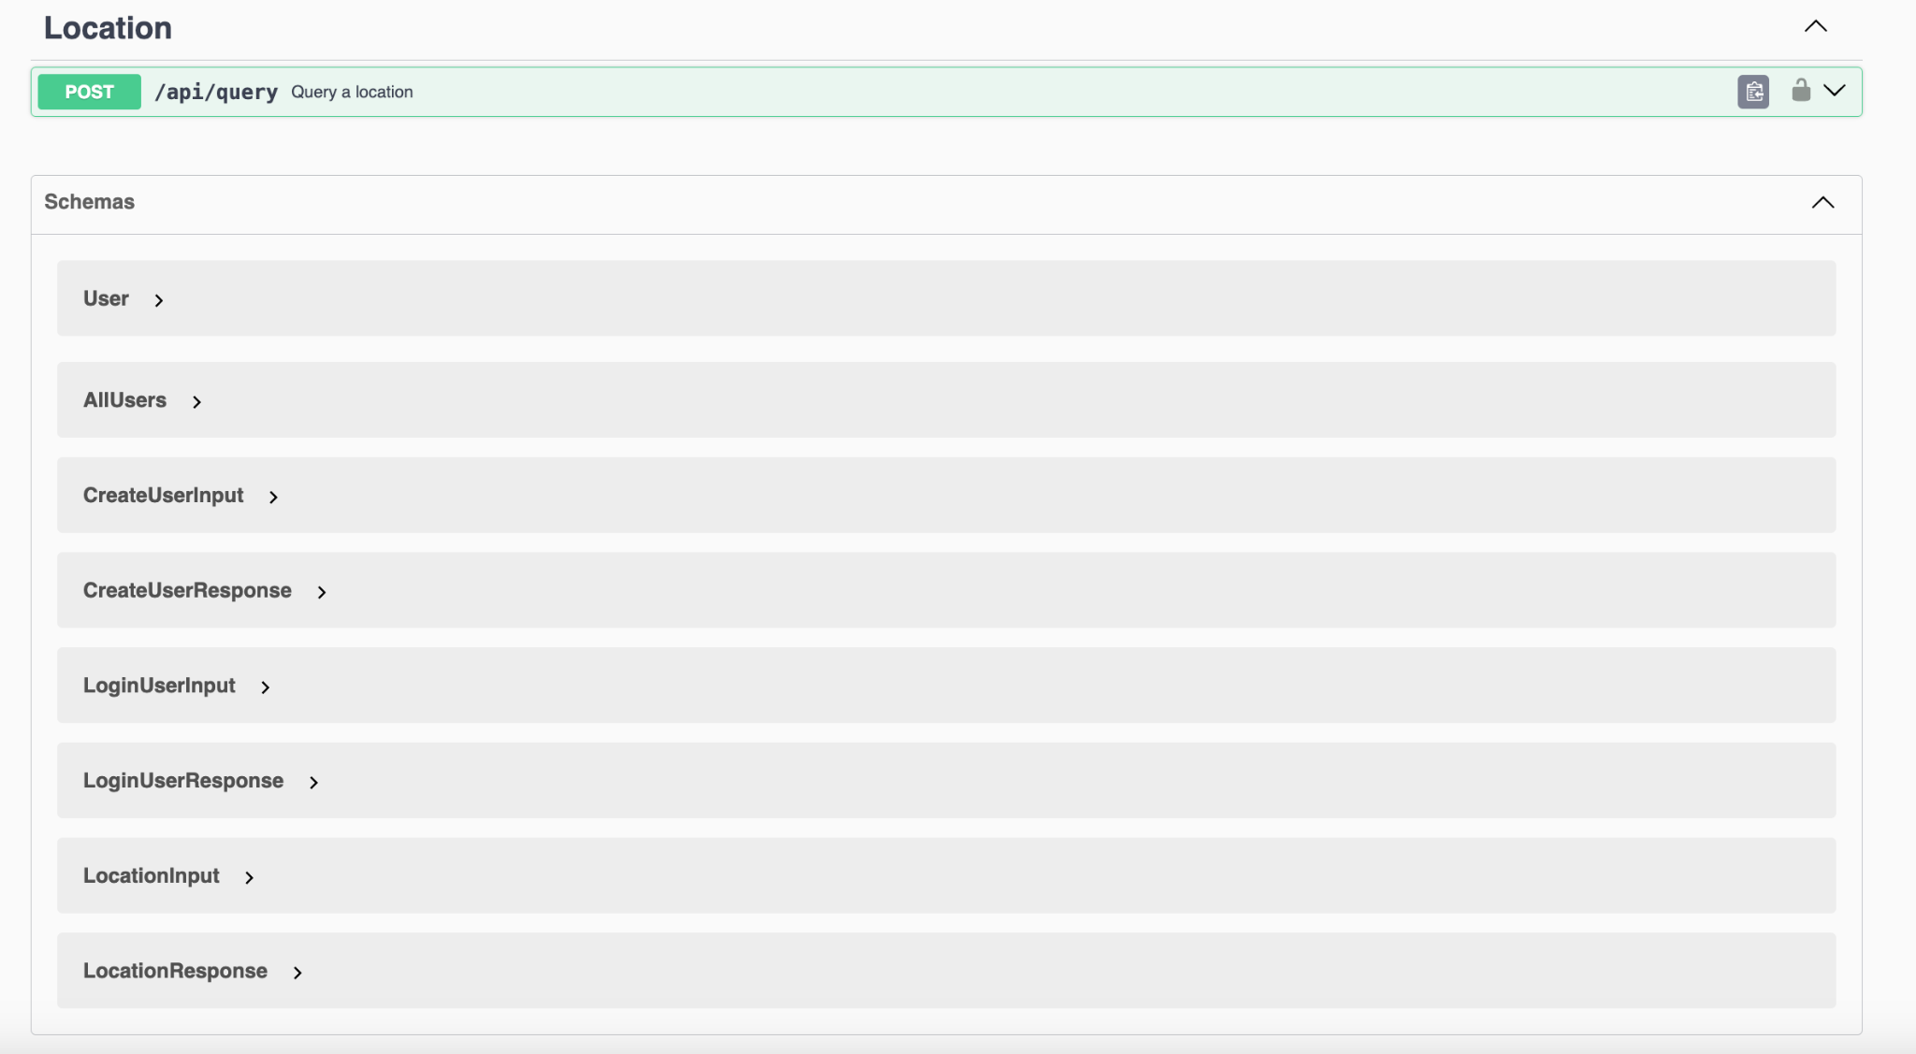

Slide 34
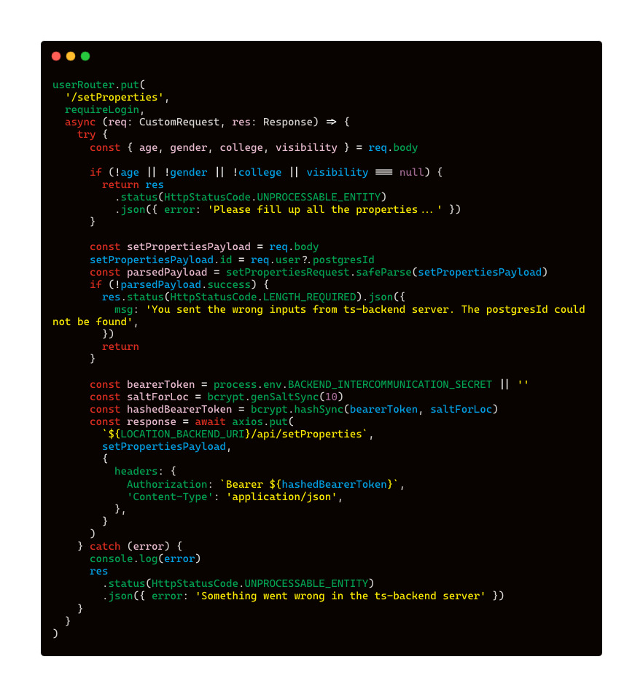
/setProperties route in ts-backend

Slide 35
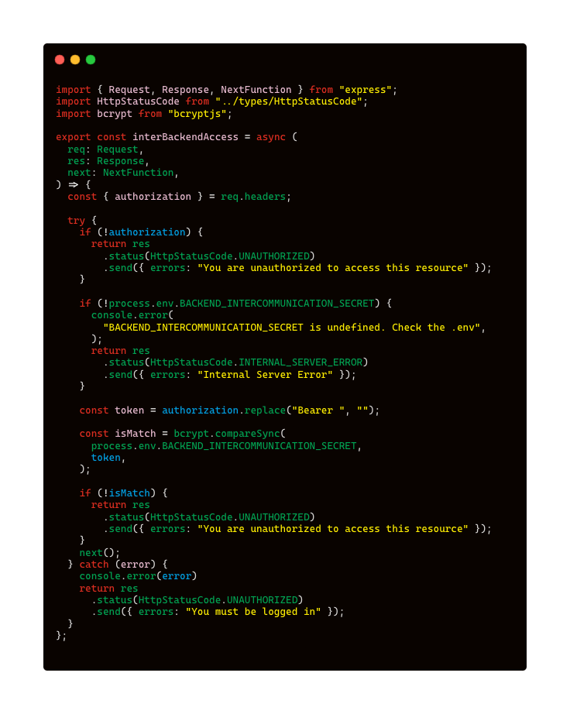
interBackendAccess middleware

Slide 36
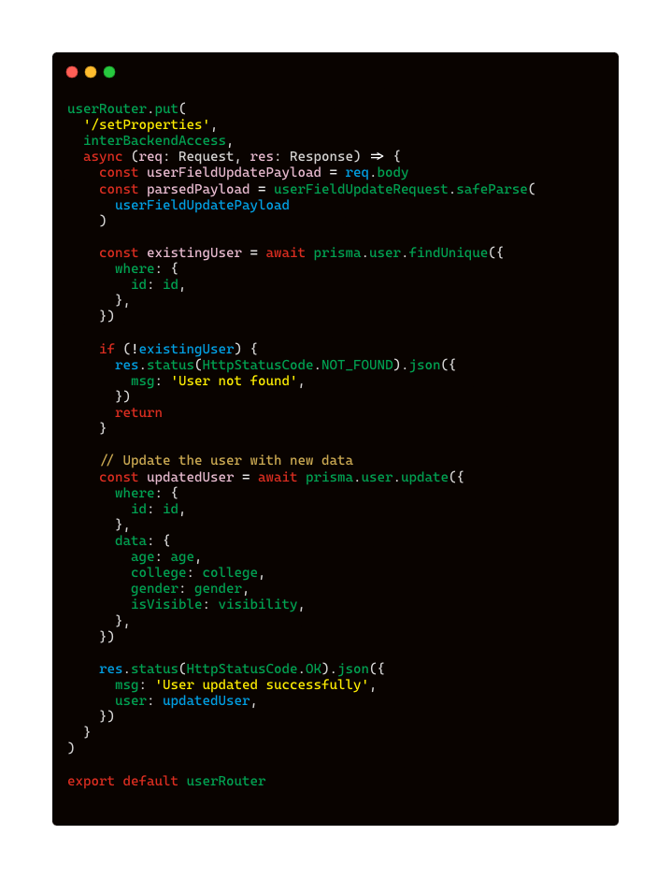
/setProperties route in loc

Slide 37
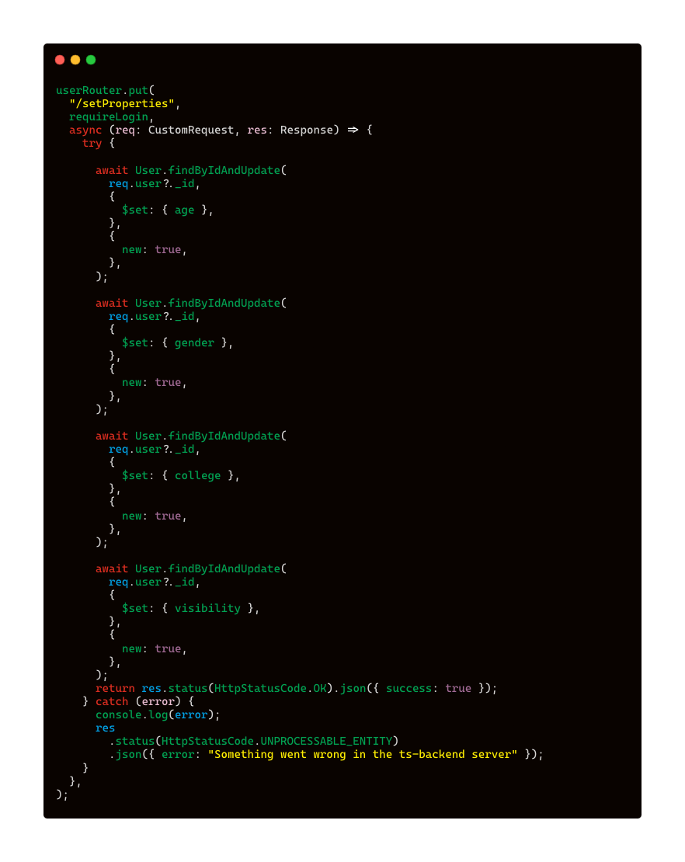
/setProperties successful in ts-backend

Slide 38
/map

Slide 39
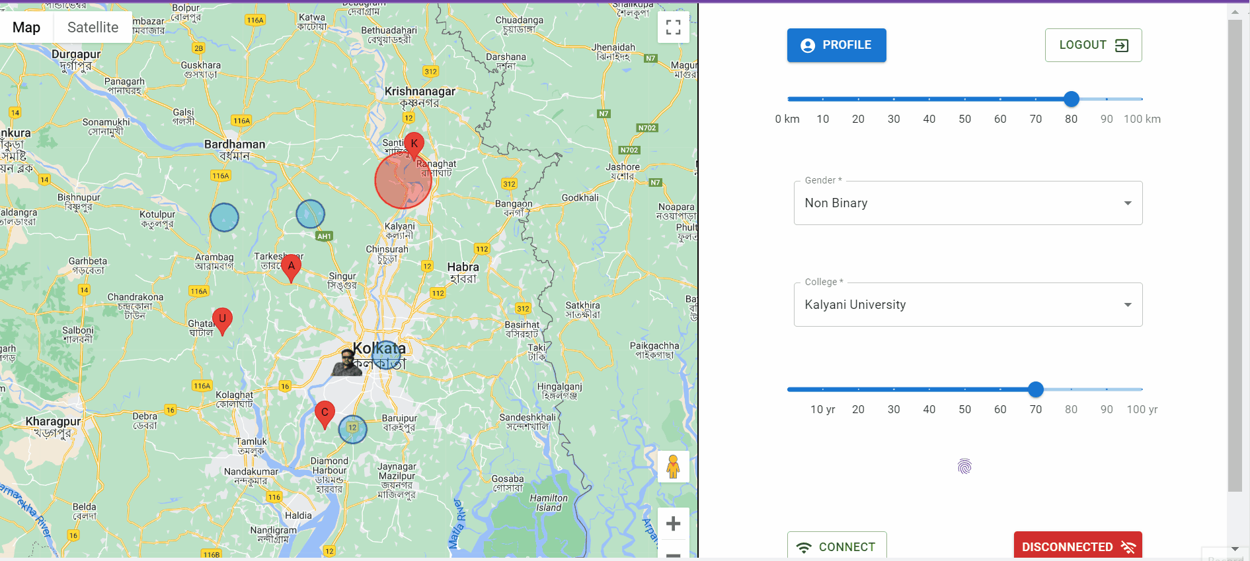
User Movement Simulation

Slide 40
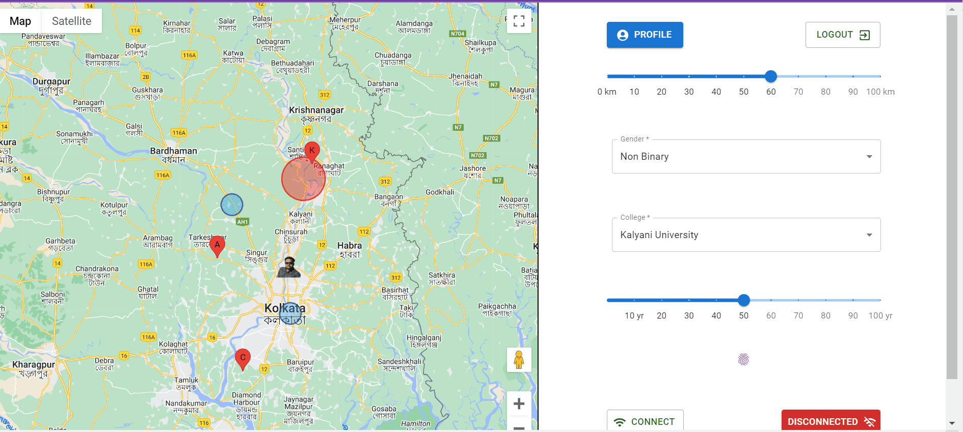
User Query

Slide 41
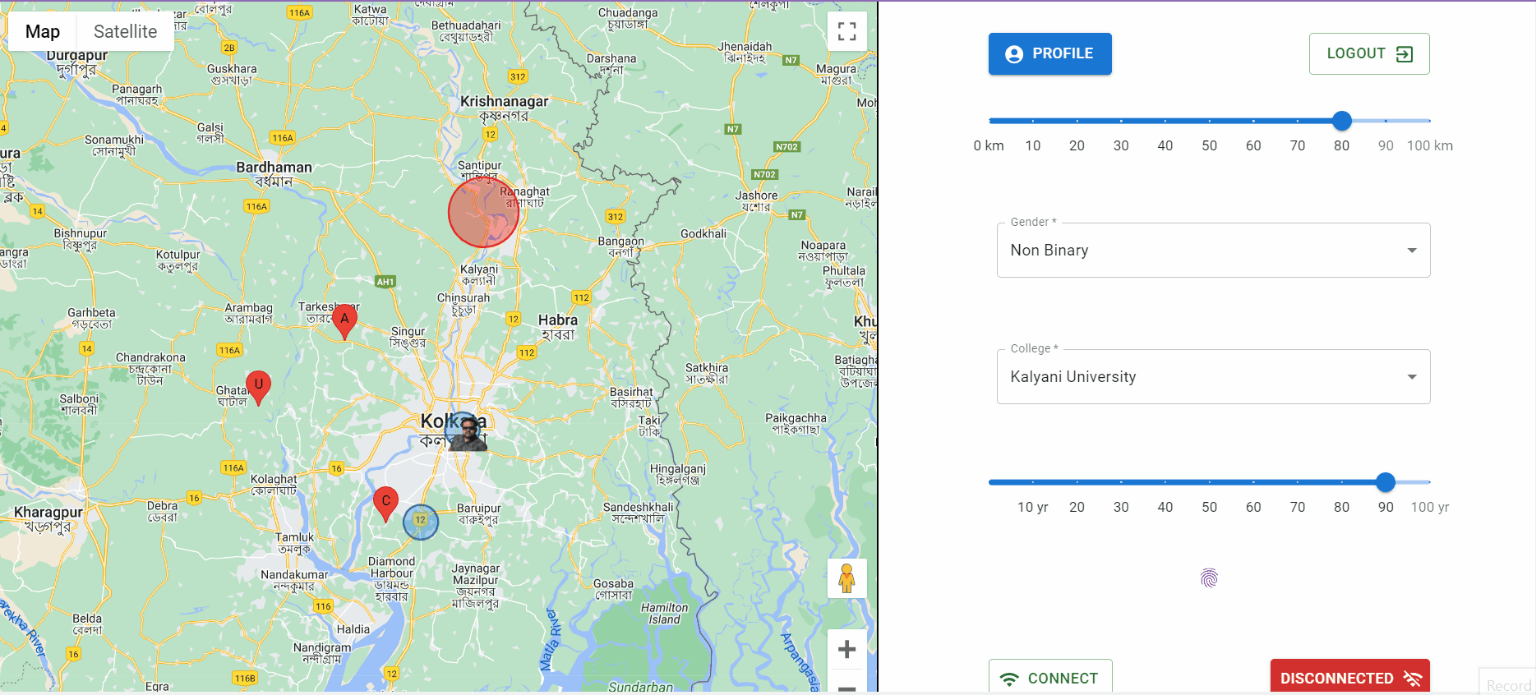
Privacy Filtering

Slide 42
User Location Updation

Slide 43
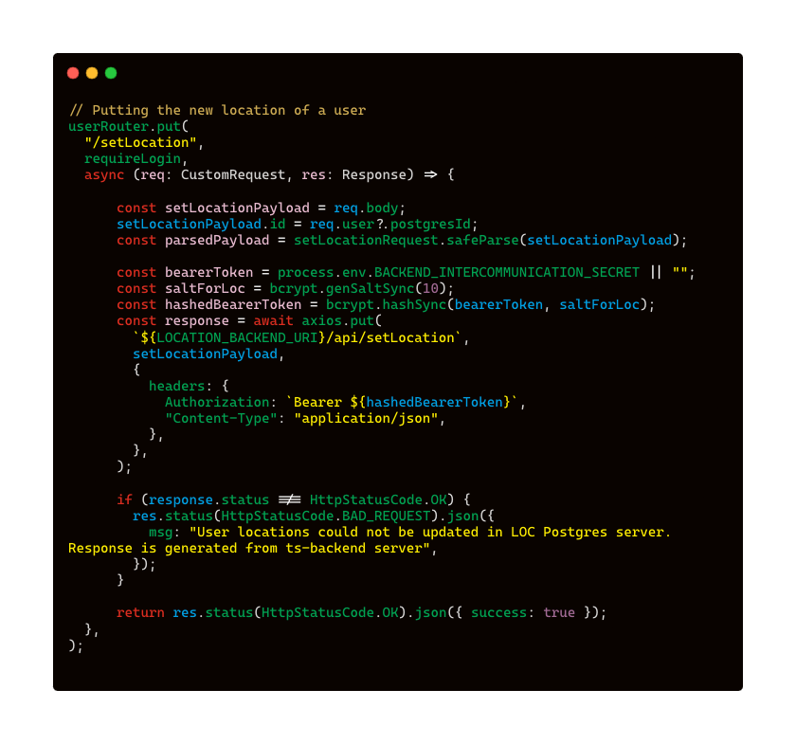
/setLocation route in ts-backend

Slide 44
interBackendAccess middleware

Slide 45
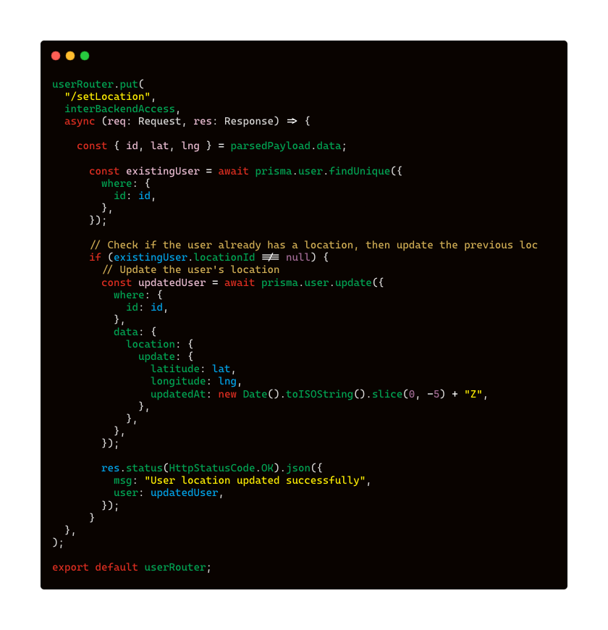
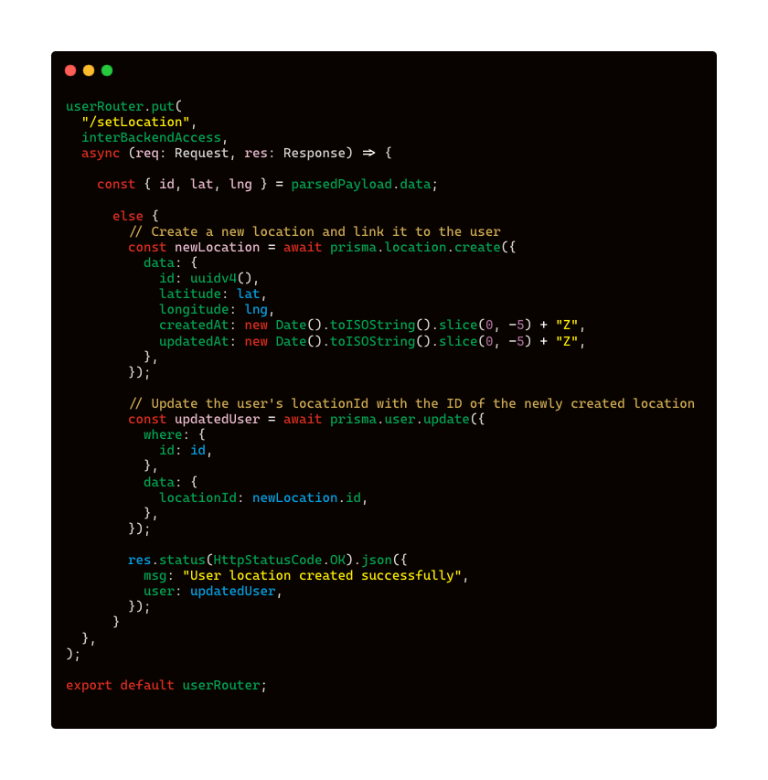

Slide 46
Privacy Query & Filtering

Slide 47
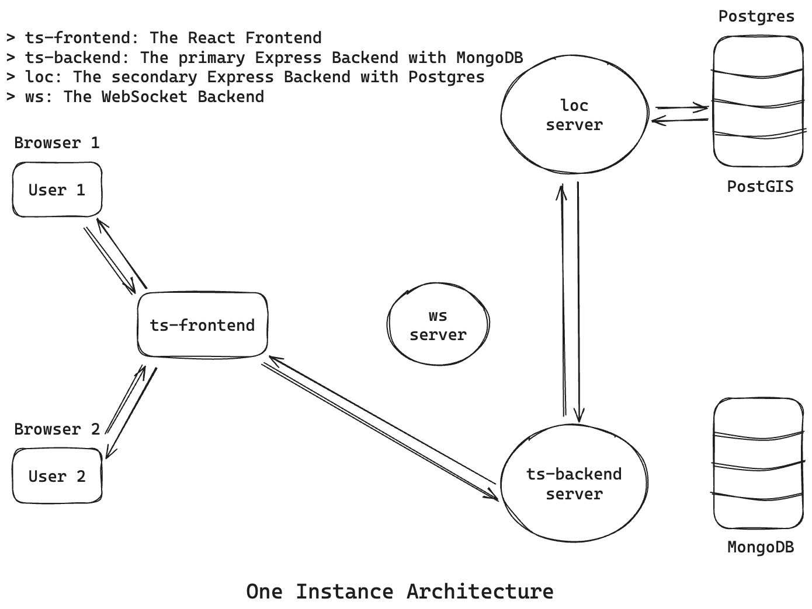

Slide 48
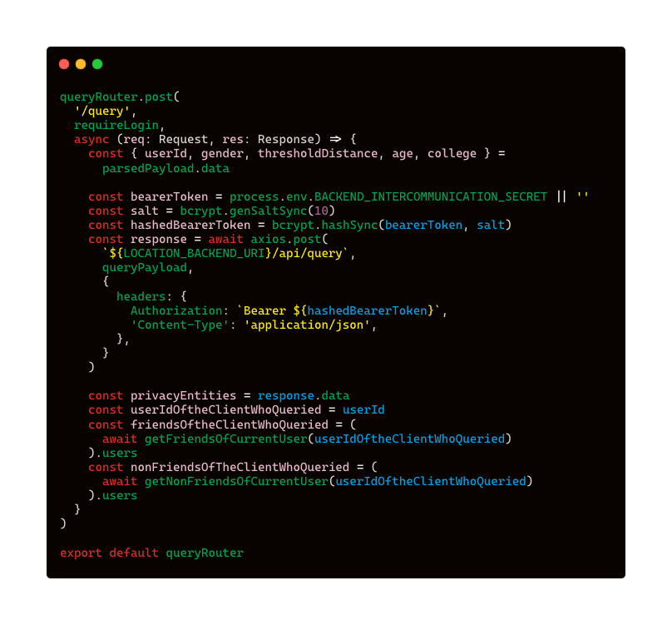
/query route in ts-backend

Slide 49
interBackendAccess middleware

Slide 50
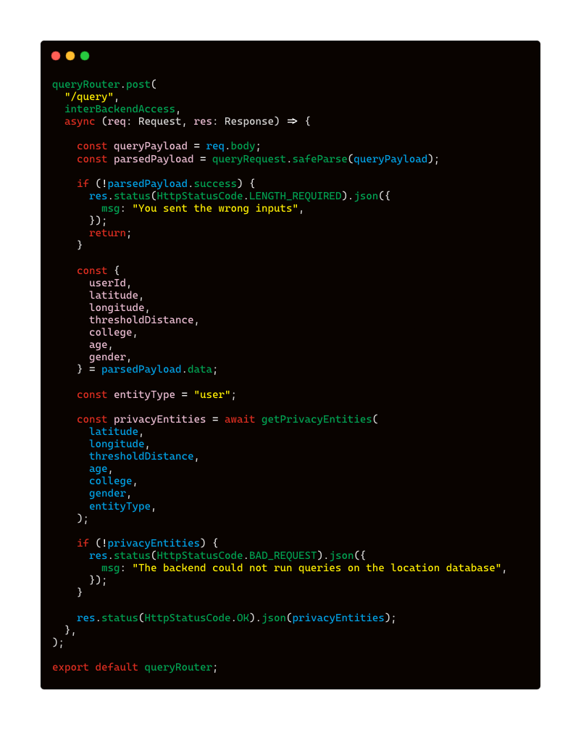
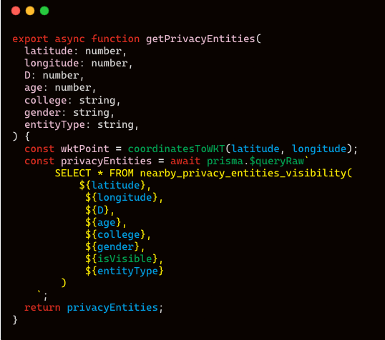
/query route in loc

Slide 51
PostgreSQL

Slide 52
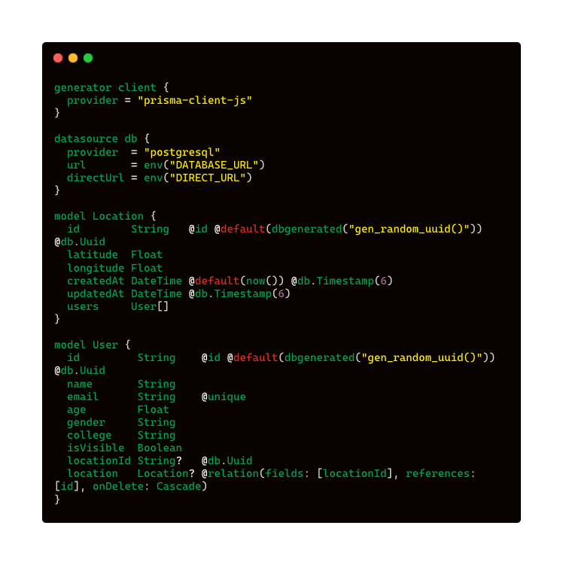
Prisma Schema

Slide 53
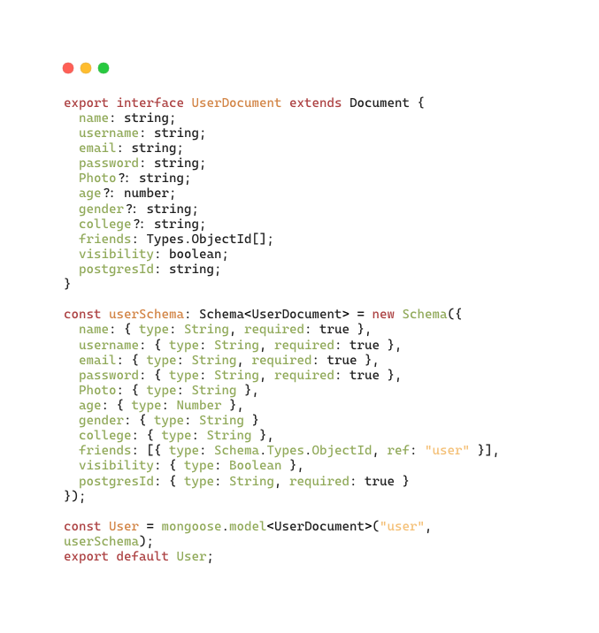
Mongoose Schema
Postgres ERD

Slide 54
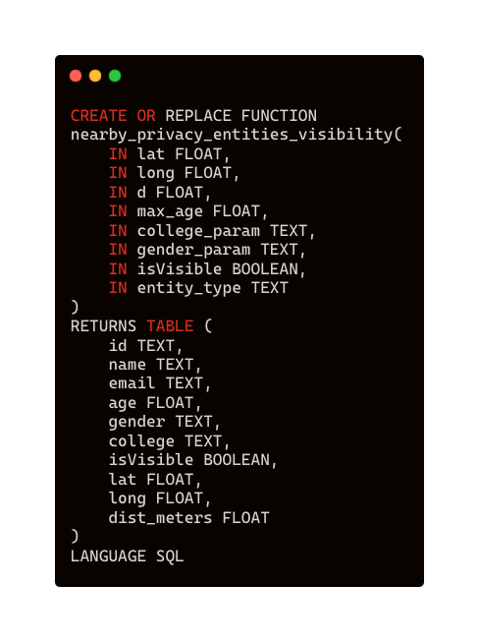
PostGIS SQL query

Slide 55
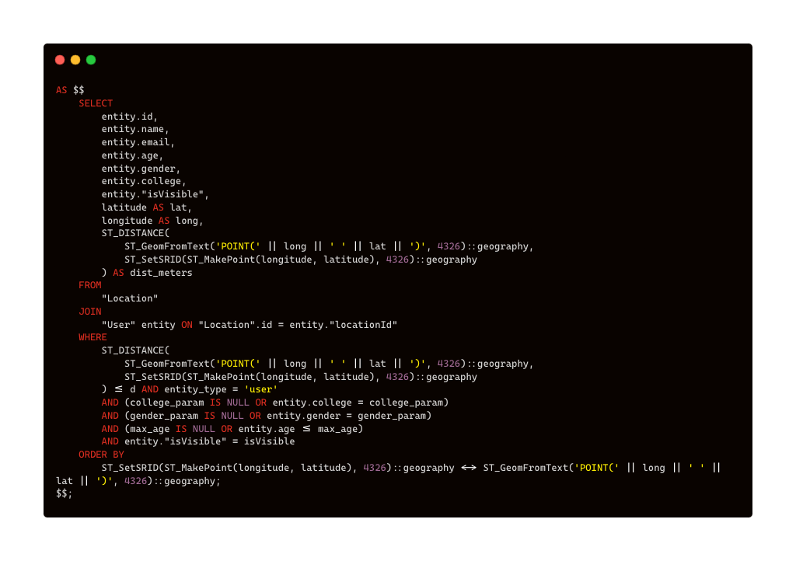
PostGIS SQL query (continued)

Slide 56
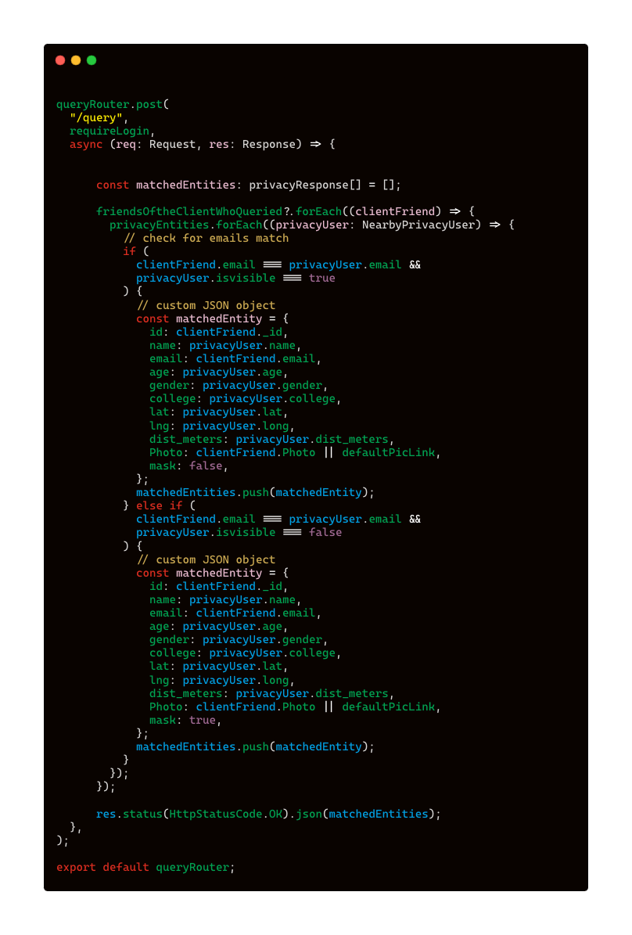
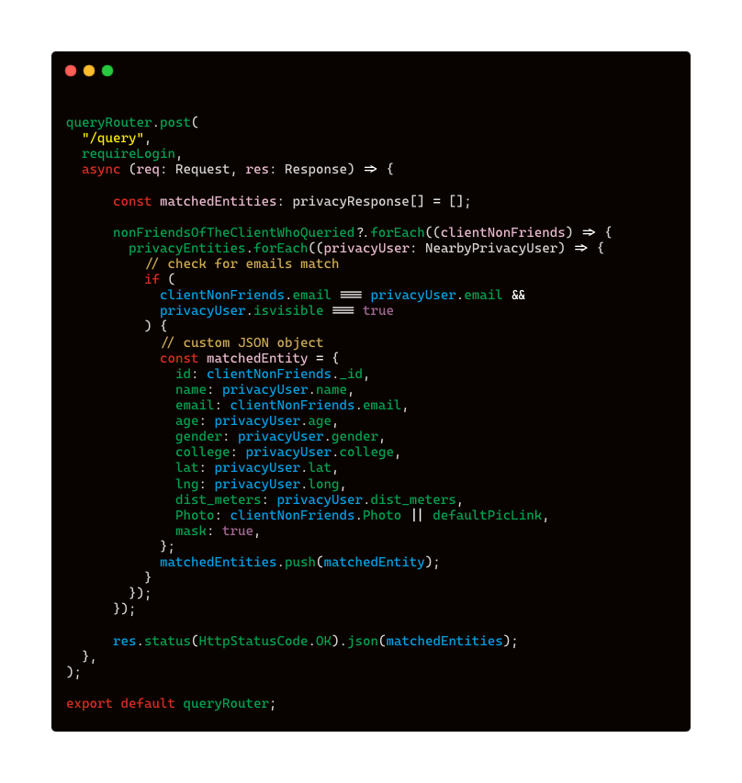
Merging responses from loc & ts-backend

Slide 57
Real Time Location Sharing

Slide 58
Real Time Location Sharing Flow

Slide 63
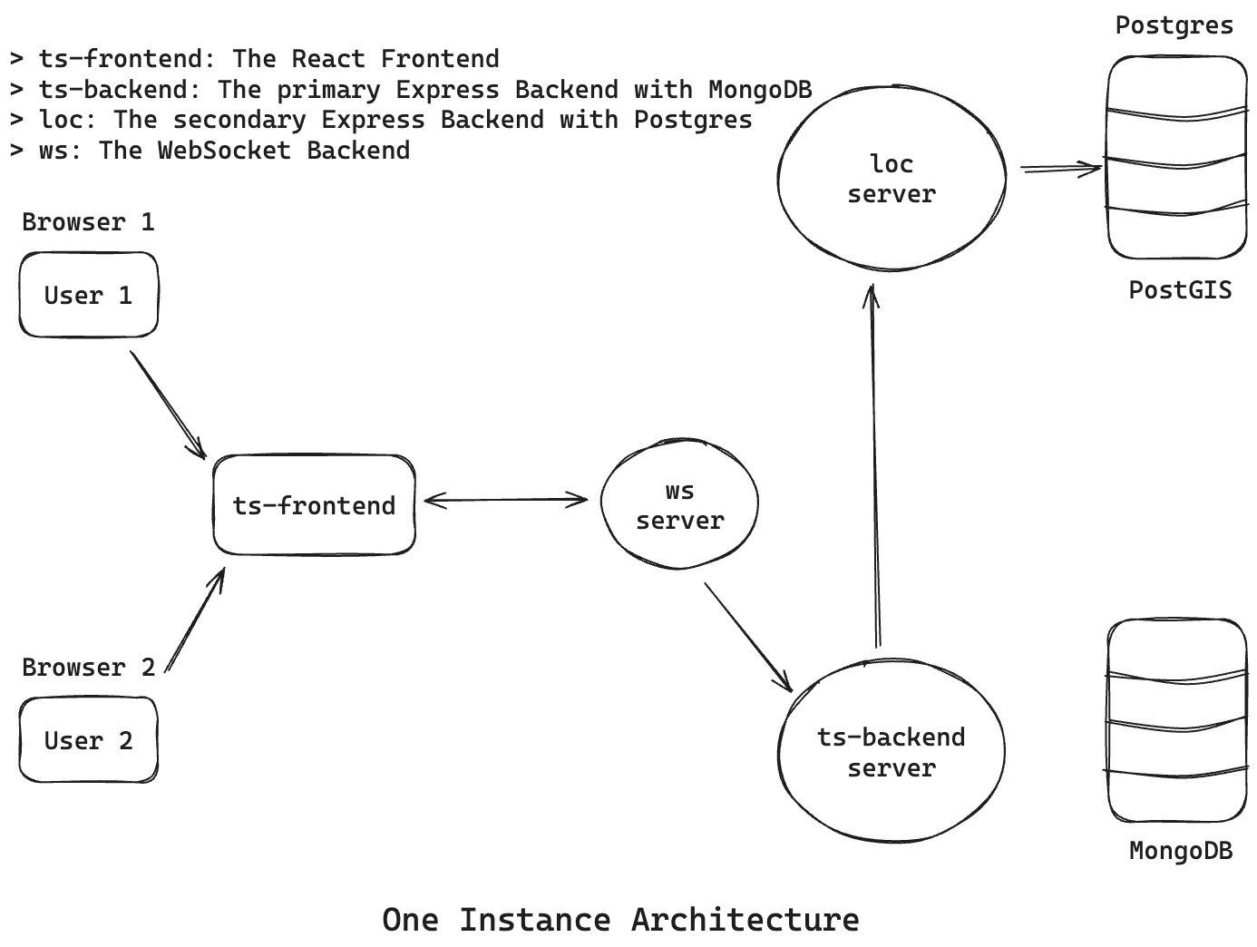

Slide 64
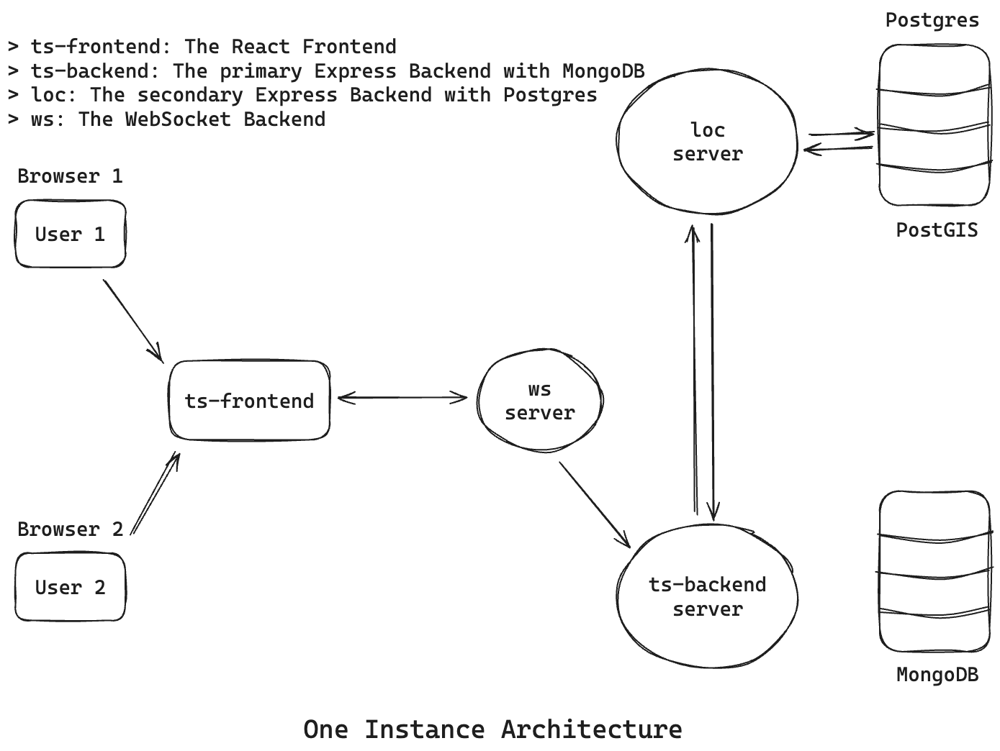

Slide 65
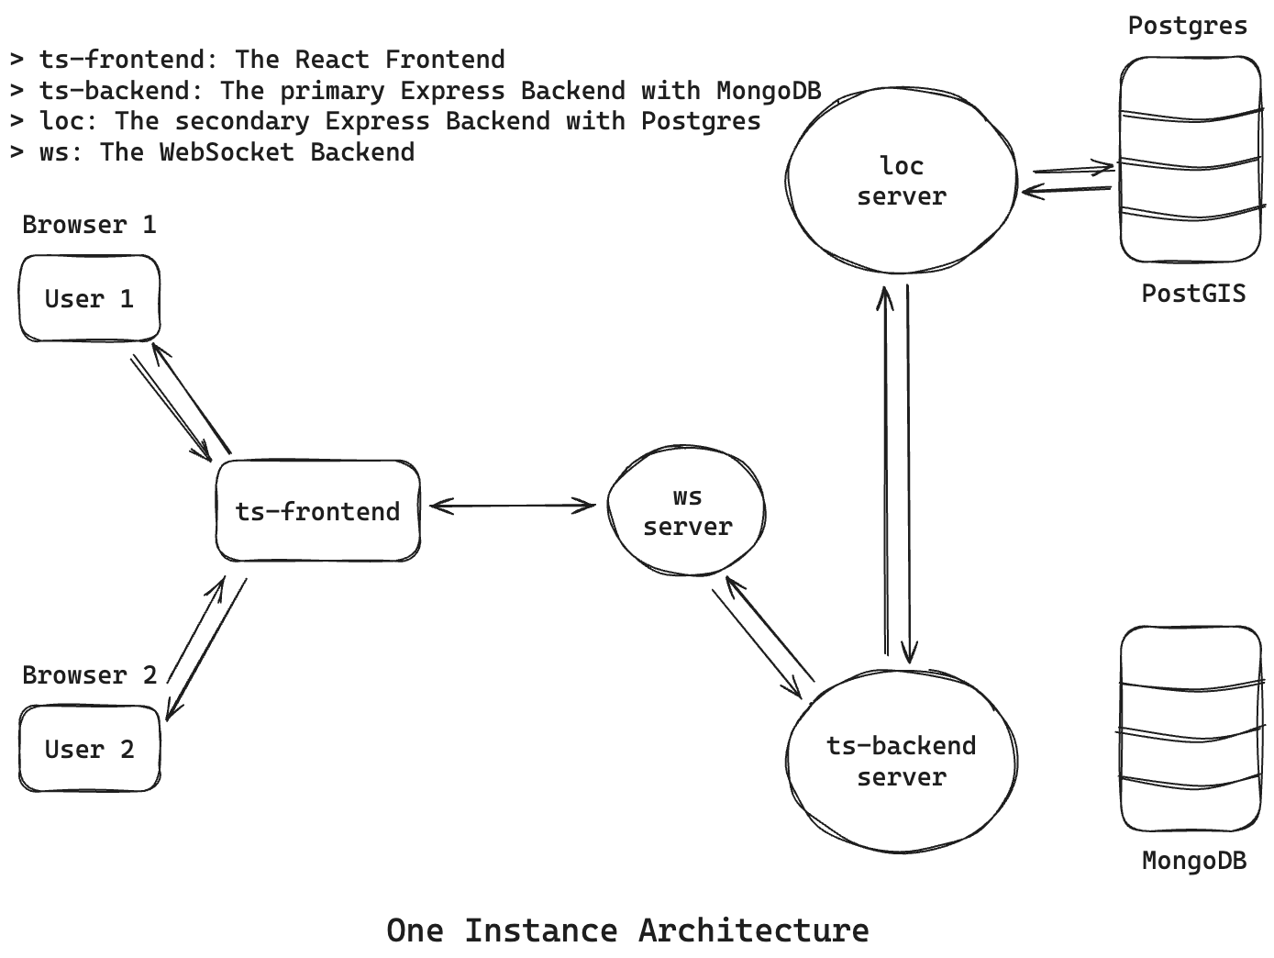

Slide 66
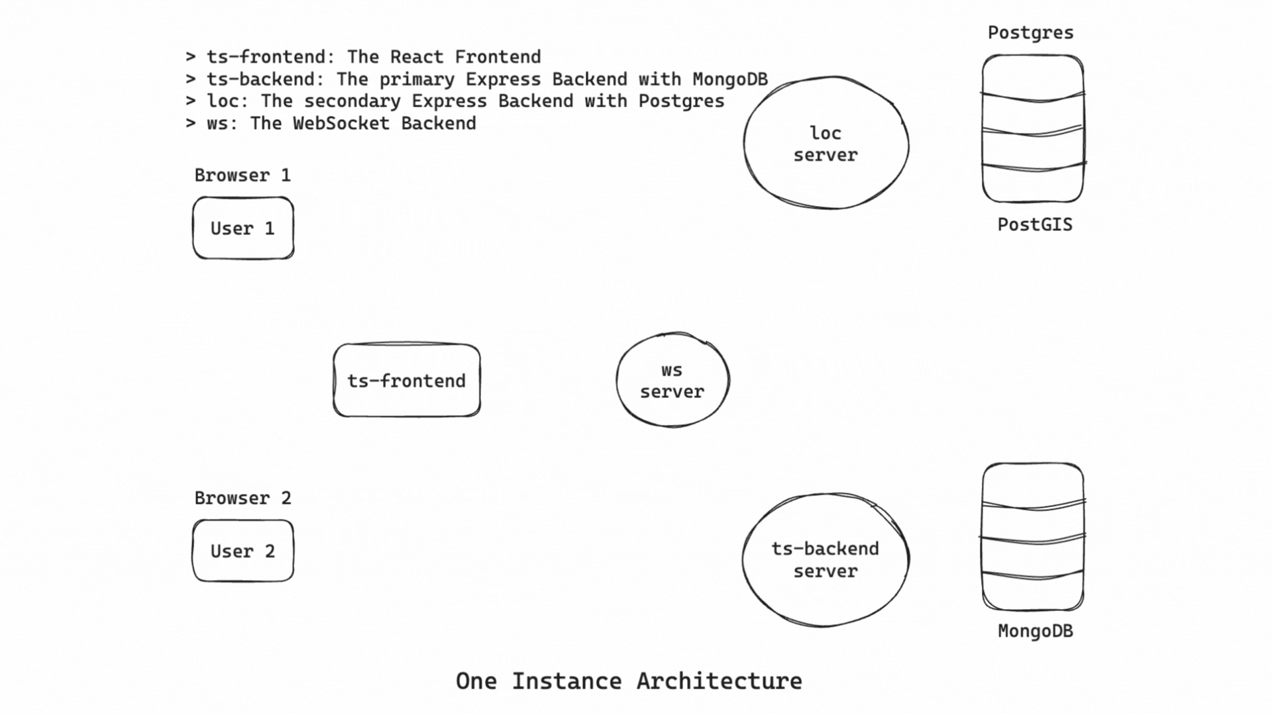

Slide 67
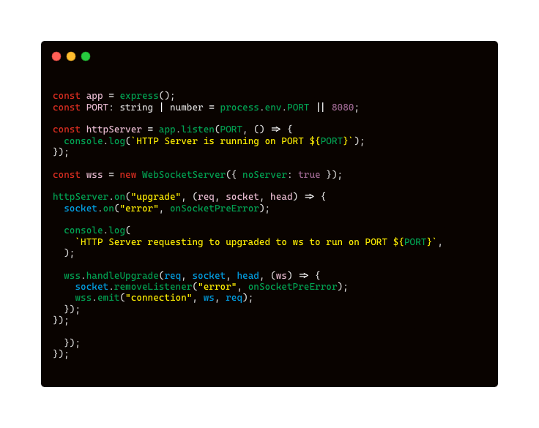
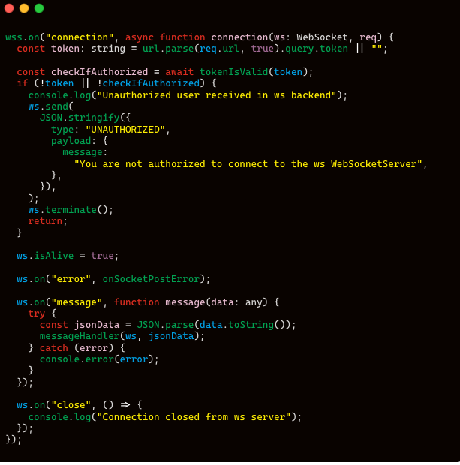
http:// to ws:// protocol upgradation

Slide 68
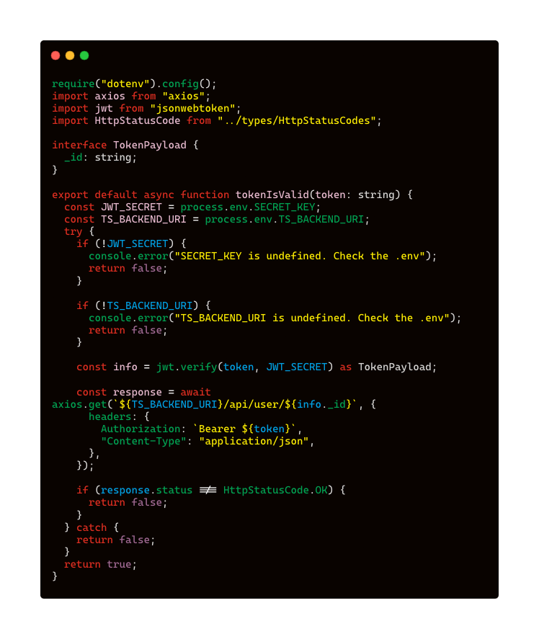
WebSocket authentication

Slide 69
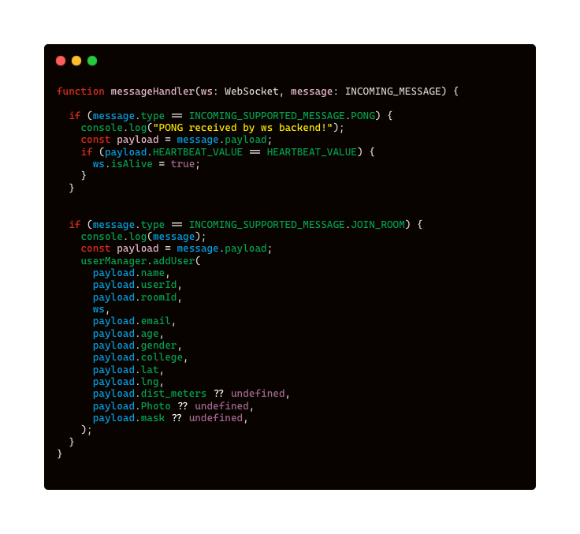
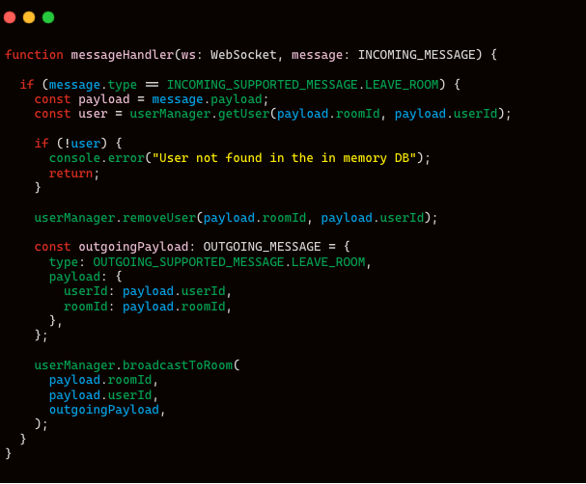
WebSocket Message Handlers

Slide 70
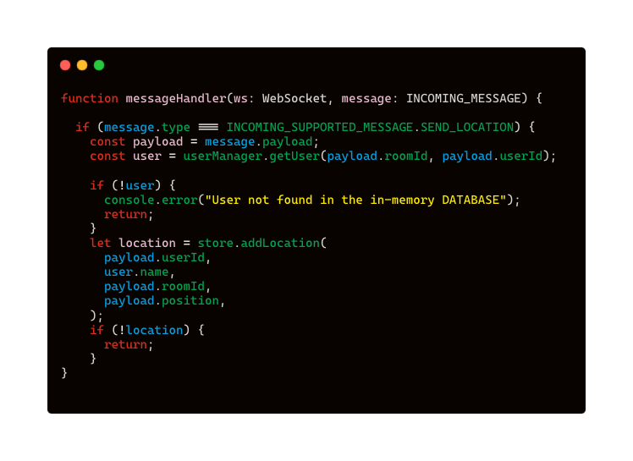
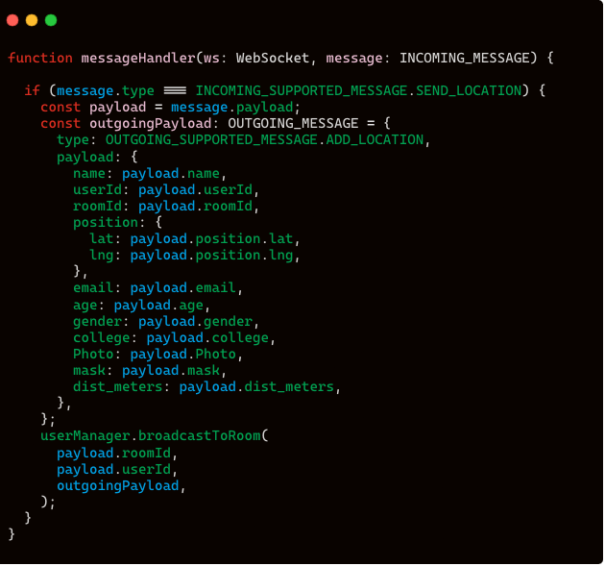
WebSocket Message Handlers

Slide 71
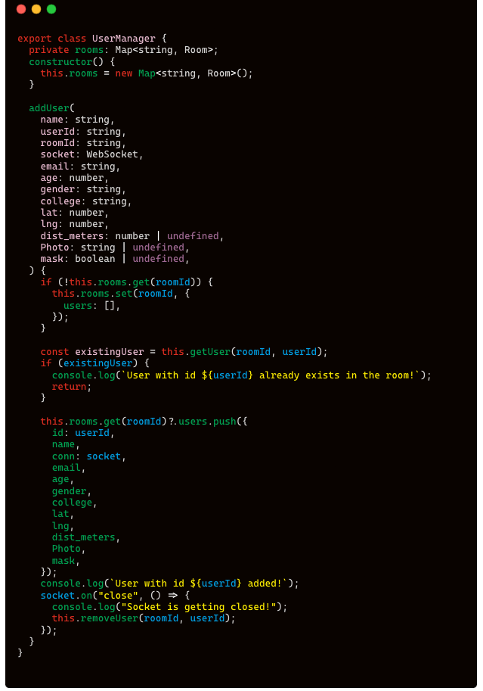
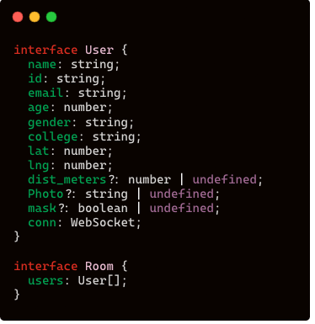
addUser(...)
WebSocket User Manager

Slide 72
WebSocket User Manager
removeUser(...)

Slide 73
Architecture

Slide 75
Conclusion

Slide 76
Conclusions
- We have established real time location sharing through WebSocket.
- We have implemented location updation and querying through PostgreSQL and PostGIS.
- Privacy Filters can mask user visibility, enhancing the privacy.

Slide 77
Limitation

Slide 78
Limitations
- TraceBook uses a WebSocket architecture for the real-time location sharing among the users
- Roughly 20,000 concurrent connections are possible for a 8GB RAM machine, and vertical scaling is capped by hardware limitations
- WebSockets are difficult to scale

Slide 79
Future Work
- Integrating a Redis Distributed Caching Layer
- Scaling the WebSocket Servers with Redis Pub-Sub and HAProxy
- Change Data Capture for Synchronization of SQL-NoSQL
Databases

Slide 80
The Architecture

Slide 81
References
https://ieeexplore.ieee.org/abstract/document/9288801 [Bhattacharya, Munmun et al.]
https://www.looptmix.com/
https://ieeexplore.ieee.org/abstract/document/7556276/ [Li, H et el.]
https://redis.io/docs/latest/develop/interact/
pubsub

Slide 82
Thank you
https://github.com/sanam2405/PrivacyNetwork
Anumoy Nandy
Kunal Pramanick
Manas Pratim Biswas
Dept. of Information Technology
Jadavpur University

Slide 83
Questions ?

